Slide 1
Mastering Blockchain Third Edition
Chapter 10, Smart Contracts

Slide 2
Outline
Ideas
History
Ricardian contracts
Templates
Oracles
Types of oracles
The DAO

Slide 3
Definition
"A smart contract is an electronic transaction protocol that executes the terms of a contract. The general objectives are to satisfy common contractual conditions (such as payment terms, liens, confidentiality, and even enforcement), minimize exceptions both malicious and accidental, and minimize the need for trusted intermediaries. Related economic goals include lowering fraud loss, arbitrations and enforcement costs, and other transaction costs."
Nick Szabo

Slide 4
Definition
A smart contract is a secure and unstoppable computer program representing an agreement that is automatically executable and enforceable.
Secure
Deterministic
Semantically sound
Unstoppable. Once executed, the smart contract cannot be halted and once deployed it usually cannot be changed.

Slide 5
Ricardian contracts
Ricardian contracts were introduced in Financial Cryptography in 7 Layers, by Ian Grigg, in the late 1990s.
It is a contract offered by an issuer to holders
It is a valuable right held by holders and managed by the issuer
It can be easily read by people (like a contract on paper)
It can be read by programs (parsable, like a database)
It is digitally signed
It carries the keys and server information
It is allied with a unique and secure identifier

Slide 6
Ricardian contract model
Ricardian contracts can record a document as a legal contract, and securely link it with other IT systems.
They use cryptographic hashes for identification
They include human-readable legal prose, and machine-readable code!

Slide 7
Smart contract templates
A framework to support legal agreements for financial instruments
Domain-Specific Languages (DSLs)
Common Language for Augmented Contract Knowledge (CLACK)

Slide 8
Oracles
Oracles act as interface between the external world and the blockchain domain.
An oracle usually takes data from the outside world, then feeds it securely to the blockchain
In some cases, the process is implemented in reverse

Slide 9
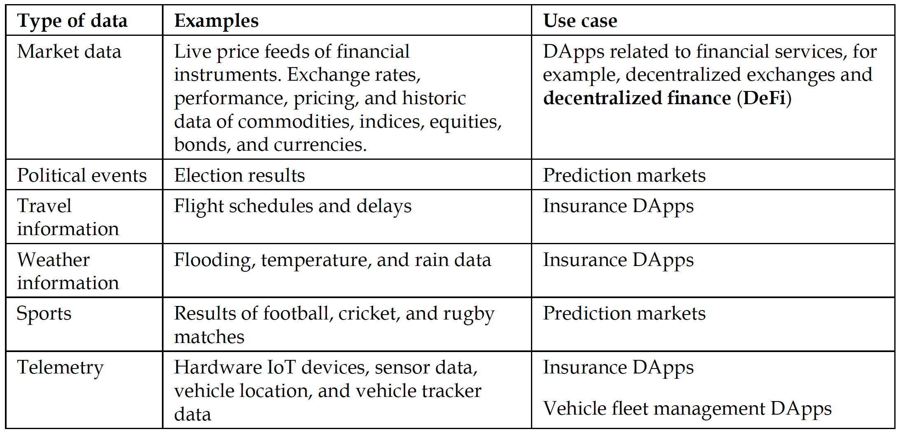
Common use cases of smart contracts

Slide 10
Generic oracle data flow

Slide 11
Proofs of data integrity and authenticity in oracles
Several type of proof are used to authenticate the integrity of the data fed to the blockchain by oracles:
Software and network-assisted proofs
TLSNotary
TLS-N based mechanism
Hardware device-assisted proofs
Android proof
Ledger proof
Trusted hardware-assisted proofs

Slide 12
Types of oracle
Inbound oracles
Software oracles
Hardware oracles
Computation oracles
Aggregation-based oracles
Crowd wisdom-driven oracles
Decentralized oracles
Smart oracles
Outbound oracles

Slide 13
The DAO
The Decentralized Autonomous Organization (DAO), started in April 2016, was a smart contract written to provide a platform for investment. Due to a bug in the code, an equivalent of approximately 3.6 million ether (roughly 50 million US dollars) was siphoned out of the DAO into another account.
Originally a platform for investment
Contained a reentrancy bug
Resulted in an Ethereum hard fork
Raised questions regarding the the code is law theory

Slide 14
Exercise
Analyze line 666 of the DAO and find reasons that why reentrancy was possible—use internet search and other sources of information as required

Slide 15
Summary
In this presentation, we considered a number of concepts related to smart contracts, including:
History
Ricardian contracts
Templates
Oracles
The DAO
An exercise to understand the DAO reentrancy bug

